Slide 1


Help keep your
school and community safe

Slide 2

allows students to report tips to a trusted adult.

Slide 3
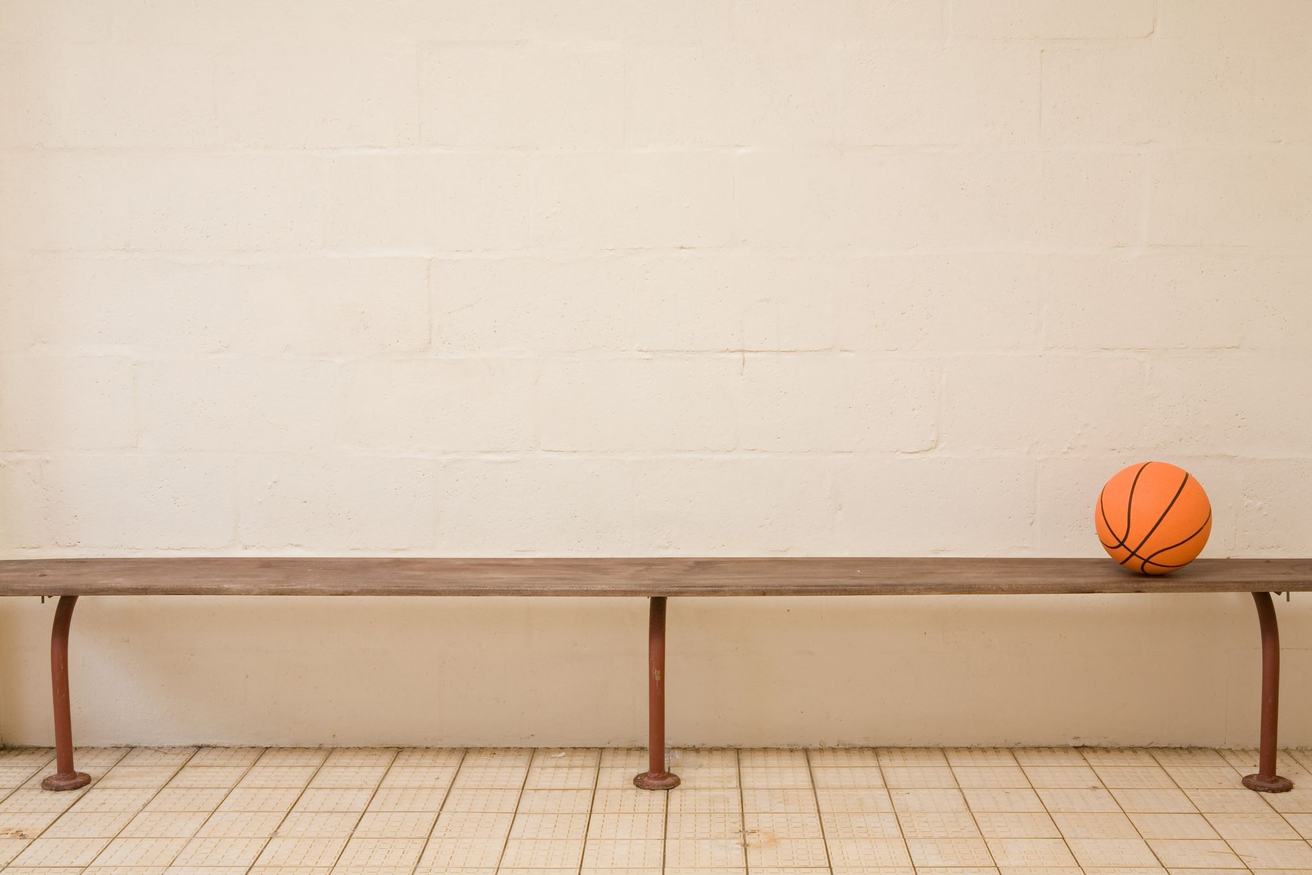
What are some dangerous situations that should be reported?
A student says they will hurt themselves
A friend is being hurt by an adult
Someone having drugs or weapons
You should always tell a trusted adult at school or at home when you hear something that doesn’t seem right. FortifyFL is another way you can report a dangerous situation.
TELL A TRUSTED ADULT OR REPORT TO:

Slide 4
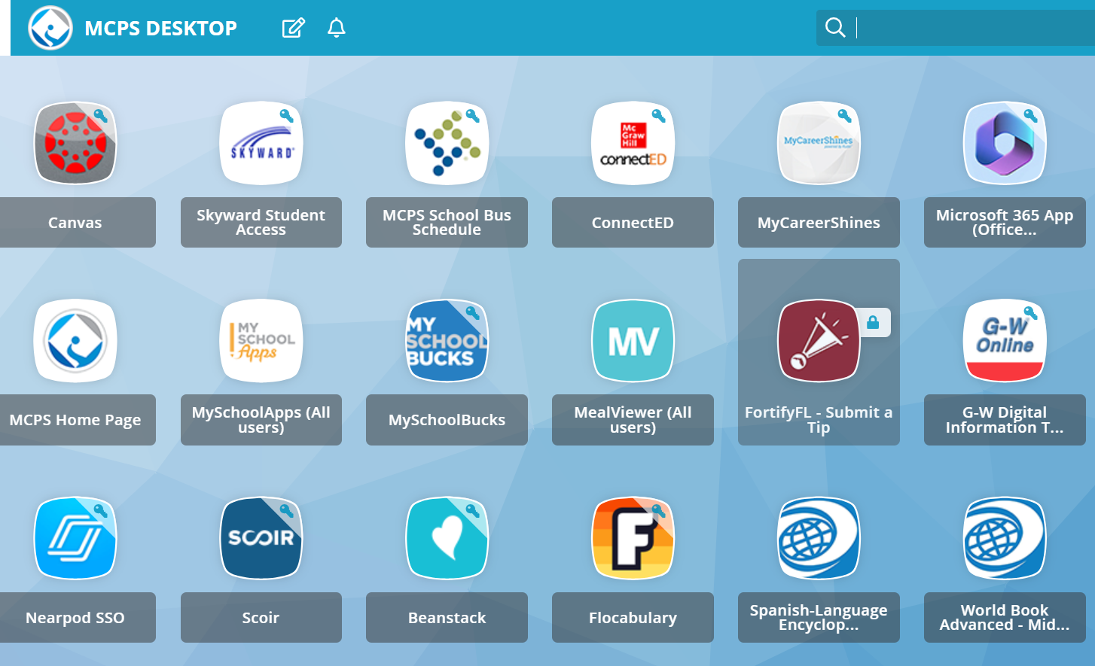
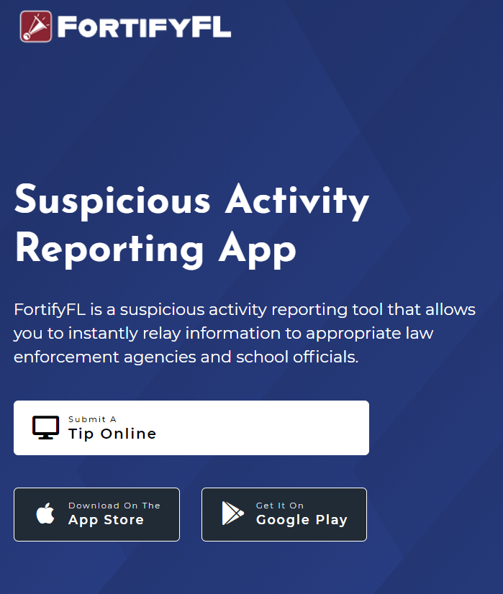
How Do I Submit A Tip?
You can get to FortifyFL from your MCPS desktop or any computer at getfortifyfl.com
Notes:
It is available on your student desktop or you can get to it from any computer.

Slide 5
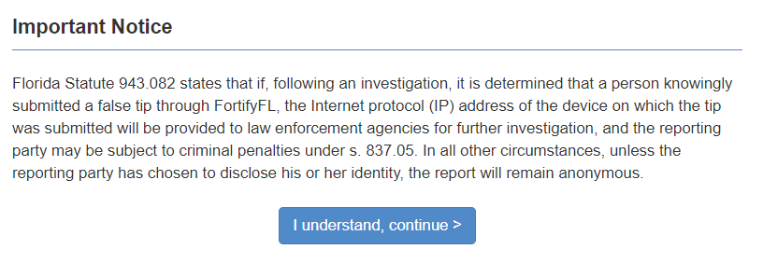
FortifyFL is for Serious Tips Only
If anyone uses FortifyFL to send a fake tip, the police will investigate. Joking around can mean serious trouble.
Notes:
FortifyFL is not for jokes. Tips that are sent through FortifyFL are taken very seriously. Joking around or sending fake stories can mean serious trouble.

Slide 6
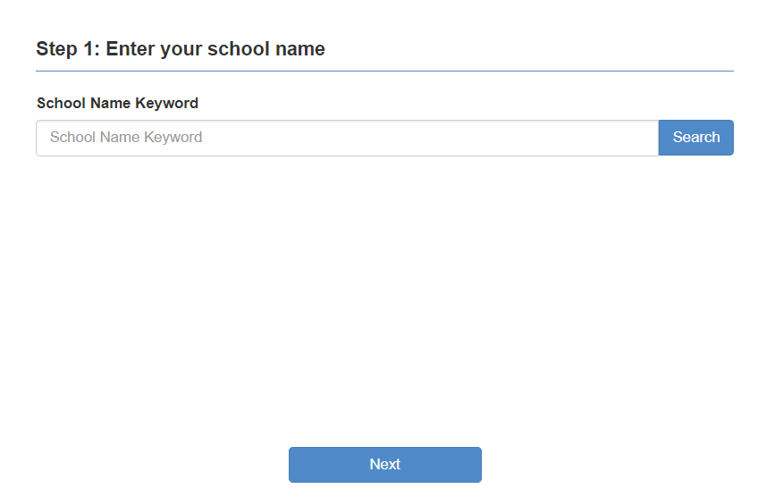
How Do I Submit A Tip?
Step 1: Select Your School

Slide 7

Tips must have useful information
This means including WHO did WHAT, WHERE it happened and WHEN.
More information will get help faster.
Notes:
“My friend Kalen (WHO) found a gun (WHAT) on the way to school yesterday (WHEN). He put it in his backpack (WHERE) because he was afraid another kid would find it and get hurt.”
This tip gives trusted adults what they need to know to keep students safe.

Slide 8
What should you do?
Call 911 for an emergency
A strange car follows you home when you walk home from school or the bus stop.
Your parent is lying on the floor and looks very sick. You cannot wake them up.
A girl on your bus has lots of bruises and cries every morning.
Go to GetFortifyFL.com
and enter a tip
You know an older student at your school that likes to hurt animals.
You hear a boy in your grade say that there are no adults at his house so he can do what he wants.
Two boys on the bus talk about having a gun. Tell a trusted adult immediately and report to FortifyFL.
A student in your class says they have drugs.
Three older girls are vaping in the restroom
Ask an adult for help
You forgot the password to get on to the computer at school.
You cannot find your backpack anywhere.
Notes:
How do you get help?
Call 911 for an emergency, when someone needs help right away because of an injury or serious danger. If you need the police, an ambulance or the fire department, call 911.
FortifyFL is for dangerous situations or when you see suspicious behavior that is not an emergency
For everything else, ask an adult for help
So, let’s talk about getting the right kind of help. What should you do if:
You cannot find your backpack anywhere.
Three older girls are vaping in the restroom.
You know an older student at your school that likes to hurt animals.
Your friend is lying on the floor and looks very sick. You cannot wake them up.
A girl on your bus has lots of bruises and cries every morning.
You forgot the password to get on to the computer at school.
You hear a boy in your grade say that there are no adults at his house so he can do what he wants.
Two boys on the bus talk about having a gun. *Tell the bus driver or a trusted adult immediately. You can also report to FortifyFL
A student in your class says they have drugs.

Slide 9

See something, say something!
Notes:
Please remember, if you see something, say something!

Slide 10

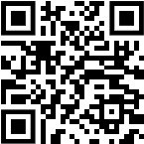
Thank you for helping to keep our school and community safe!
Notes:
For the teacher - If there are questions about why we have FortifyFL, here is the history:
FortifyFL was created in 2018 by the Florida Legislature after a tragedy at Marjory Stoneman Douglas High School.
FortifyFL was named by students from Marjory Stoneman Douglas High School. Many people worked together to create FortifyFL as a way for students to get help and keep their school and community safe.

